Slide 2
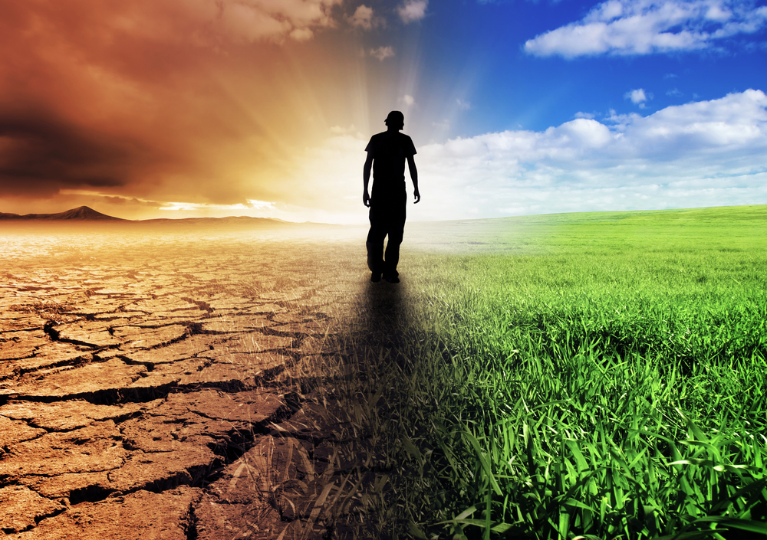
Impact and Implications of Climate Change on Sugarcane Crop in Pakistan
By
Dr. Muhammad Afzal
Sugarcane Consultant

Slide 3
Definition
The climate of a city or region is its typical or average weather. For example, the climate of Punjab is sunny and warm in summer. But the climate of Antarctica is freezing cold. Earth's climate is the average of all the world's regional climates.
Climate change is a long-term and large-scale change in the usual weather patterns found in a place. This could be a change in how much rain a place usually gets in a year or it could be a change in a place's usual temperature for a month or season. Same is true for Earth’s total climate changes.
Climate change is primarily attributed to the increased levels of CO₂ and other greenhouse gases in earth’s atmosphere due to increased human use of fossil fuels, which resulted in devastating impacts in the form of more frequent and severe floods, drought, heat waves, changes in rainfall pattern and increase in sea level etc.

Slide 4
Introduction
As many systems are tied to climate, a change in climate can affect many related aspects of where and how people, plants and animals live, such as food production, availability and use of water, and health risks. For example, a change in the usual timing of rains or temperatures can affect when plants blossom and set fruit, when insects hatch or when streams are their fullest. This can affect historically synchronized pollination of crops, food for migrating birds, spawning of fish, water supplies for drinking and irrigation, forest health, and so on.

Slide 5
Atmospheric CO₂ concentration has increased by about 30% since the mid-18th century due to increases in combustion of fossil fuels, industrial processes, and deforestation. It is projected that atmospheric CO₂ would increase from current levels to about 550 ppm in low emission scenario or could double in a high emission scenario by the end of the 21st century.
Elevated atmospheric CO₂ increases sugarcane photosynthesis, water use efficiency, biomass, and productivity. Improved water use efficiency of sugarcane under elevated CO2 is mainly associated with the reduced stomata conductance.
It is predicted that cane yield in 2050 could be 15–59% higher than that at the current average level.
The most significantly positive effect would be on reduced incidence of frost, which is a major limitation on production in most regions in Punjab where growing season is short.

Slide 6
Sugarcane Impact on Climate
In a region, changes in farming systems and crop combinations may directly or indirectly affect local climate factors. Residue burning before or after sugarcane harvest is a common management practice of sugarcane production in many countries. Greenhouse gas emission in sugarcane production is the major concern. A recent research indicated that approximate 2.4 tons of CO₂ equivalent ha⁻¹ was released to the atmosphere by sugarcane crop. The major contributors of the released CO₂ from sugarcane were residue burning (44%), the utilization of synthetic fertilizers (20%), and fossil fuel combustion (18%). Therefore, improving green harvest can increase soil organic carbon and reduce CO₂ emission from sugarcane production.
However sugarcane can relatively increase carbon fixation because of its C₄ carbon fixation characteristics. Hence, sugarcane may be better than other field crops for environmental protection in decreasing atmospheric CO₂ and surface temperature.

Slide 7
A negative effect of increased temperature may occur in the tropical regions where cool winters are required to slow plant growth and increase sucrose storage.
A significant proportion of sugarcane is grown along coastal areas. Any increase in sea level would require large areas to be abandoned.
Sugarcane production is highly vulnerable to climate change due to increased frequency and intensity of the extreme weather events, such as drought, heat, flooding, and frost.
The incidence of smut disease is likely to increase due to high temperatures.
Growers used fungicides to control the negative effects of rusts on yields, but the cost of three split applications of fungicides (at a hectare level) during a growing season was equivalent to 3 tons of cane yield lost per hectare.

Slide 8
The more extreme weather events due to climate change have caused more overwintering pests (weeds and insects), more disease pathogens, and more input costs for reducing these risks to maintain a certain level of sugarcane production. For instance, sugarcane leaf brown rust is a big challenge for sugarcane production. Severity of rusts is associated with winter temperature and relative humidity in the region.

Slide 9
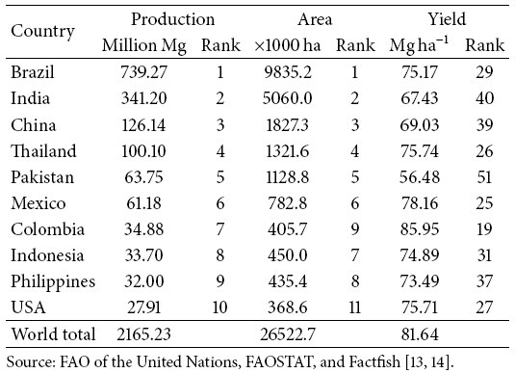
The world top 10 sugarcane production countries in 2013 for their cane production, hectarage, and cane yield as well as their ranks in 103 sugarcane production countries

Slide 10
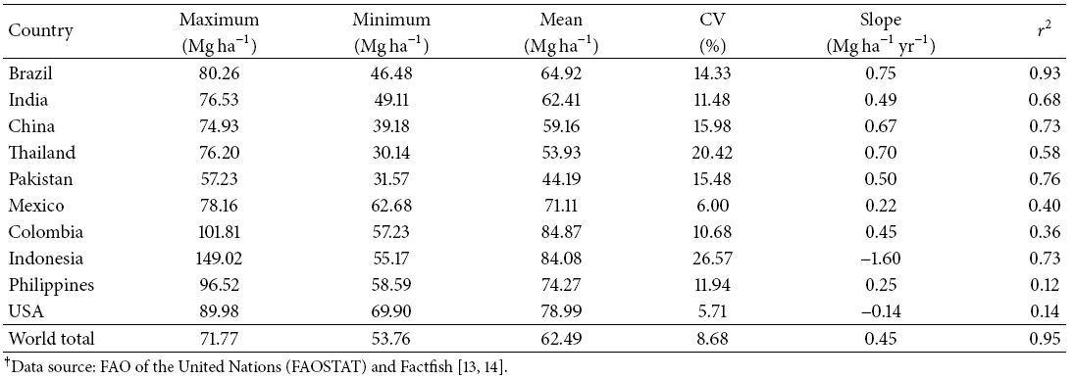
Maximum, minimum, and mean cane yields and coefficient of variation (CV) across last 41 years (1973–2013) for the world top 10 sugarcane production countries. The slope and values of linear regression cane yield and year for each country are listed in the table.

Slide 11
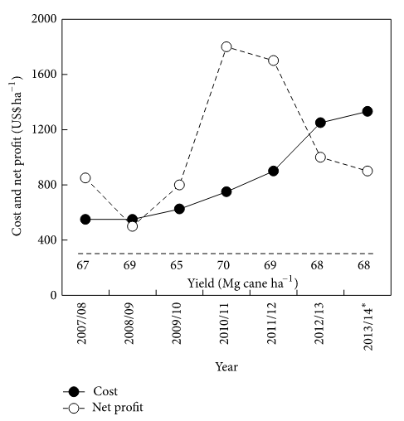
Average labor cost, net profit, and cane yield in major sugarcane production regions in China from 2007 to 2014, based on post-estimate. Data are adopted from Anderson-Sprecher and Jiang.

Slide 12
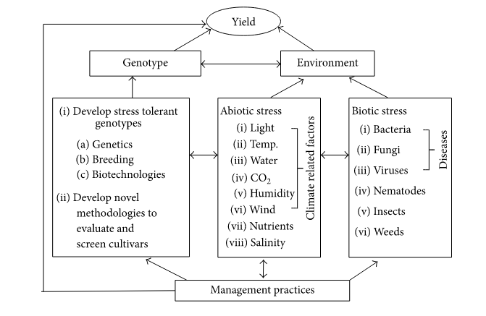
A flow chart to demonstrate major factors (genotype, environment, and management practices) influencing sugarcane yield as well as their interactions.

Slide 13
Challenges for Sugarcane Production
When assessing agriculture and crop production systems as well as climate change and its negative impact on crop production, many economic, environmental, and social issues have to be thoroughly considered, such as how to
(1) Balance short-term and long-term goals.
(2) Increase productivity, profitability, and sustainability.
(3) Introduce new technologies and transfer them to
growers.
(4) Meet environmental regulations.
(5) Deal with contradictions between climate change and crop production.
Balance competition of food and energy in resources.
Certainly, sugarcane production systems are also challenged by these specific issues.

Slide 14
Mitigating Impact of Stressed Environment and Sustaining Sugarcane Production
The increased cane production was associated with increases in both hectarage and cane yield in most developing countries . Much more efforts are needed to focus on for increasing yield and improving profits under the current conditions and in the future climate change. Sugarcane yield relies on crop varieties (genotypes), biotic and abiotic growth environments (i.e., insects, diseases, weeds, and other climate related factors), and management practices.
Some mitigation and adaptation strategies for climate change in sugarcane production include planting drought tolerant varieties, investing irrigation infrastructure, improving irrigation efficiency and drainage systems, and improving cultural and management practices.

Slide 15
Studies have shown that some genotypes/cultivars are better than others in tolerance to water deficit and low temperature stresses, in radiation use efficiency and in nutrient use efficiency.
Thus, development of the stress tolerant and high-yielding sugarcane cultivars is one of the important strategies in adaptation of climate changes.
Sugarcane breeders and other scientists can develop computer data base to design hybridization (within or between species) for special requirement in the breeding programs.
Use growth and physiological traits to screen elite clones for resistance/tolerance to biotic and abiotic stresses and use gene transformation technologies to improve breeding and selection efficiencies.
Using technology of gene transformation to develop genetically modified (GM) sugarcane varieties such as herbicide glyphosate resistance, drought tolerance, high sugar content, and disease resistance sugarcane varieties.

Slide 16
It is further suggested that each of the leading sugarcane cultivars in a region may not be over 25% of total hectarage in order to mitigate negative effects of the extreme climate events on sugarcane production and to reduce risk of yield losses by some unexpected insects and diseases.
In addition to development of disease resistant cultivars by breeding and variety development programs, integration of the best management practices (BMPs) for pest control and for increases in water and nutrient use efficiencies is also crucial for the climate change adaptation and sugarcane yield improvement.

Slide 18
Summary and Future Perspectives
Clearly, sugarcane production has been and will continue to be directly or indirectly affected by changes in climate conditions. The most significant challenges for sugarcane production are increases in frequency and intensity of extreme weather events, especially drought during climate change. Existing adaptation strategies can help offset many but not all effects in the future. The negative effects of climate change on sugarcane production are very likely to worsen after 2050, especially if greenhouse gas emissions still remain high.
Therefore, agricultural scientists and decision makers need to work closely to mitigate the potential negative effects of climate change on agriculture and to improve sugarcane yields by multidisciplinary approaches, such as consistently developing new sugarcane cultivars using breeding and molecular biology, refining best management practices, improving new technology transfer, and increasing productivity and profitability. Improving the resilience of sugarcane production systems to climate change requires protection of the natural resource (especially water and soil) for sustainability. Expanding use of sugarcane products for sugar, ethanol, cellulosic biofuel, and other coproducts can further improve profits.

Slide 19
Introduction
Sugarcane (Saccharum officinarum L.) is an important crop for sugar and bioenergy worldwide. The increasing greenhouse gas emission and global warming during climate change result in the increased frequency and intensity of extreme weather events. Climate change is expected to have important consequences for sugarcane production in the world, especially in the developing countries because of relatively low adaptive capacity, high vulnerability to natural hazards, and poor forecasting systems and mitigating strategies. Sugarcane production may have been negatively affected and will continue to be considerably affected by increases in the frequency and intensity of extreme environmental conditions due to climate change. The degree of climate change impact on sugarcane is associated with geographic location and adaptive capacity. In this paper, we briefly reviewed sugarcane response to climate change events, sugarcane production in several different countries, and challenges for sugarcane production in climate change in order for us to better understand effects of climate change on sugarcane production and to propose strategies for mitigating the negative impacts of climate change and improving sugarcane production sustainability and profitability.

